Slide 1
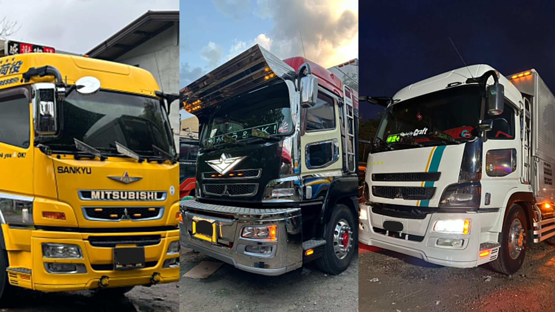

WMR Trucking Services
Delivery Request System
Obguia, Earl Lawrence
Loremas, Joemire Dave
Llerin, Andre John

Slide 2

What is WMR
Trucking Services
WMR Trucking Services is a logistics company that offers truck rental and cargo delivery services. It helps clients transport goods safely and efficiently to different locations. The company manages drivers, trucks, and deliveries to ensure smooth operations.

Slide 3
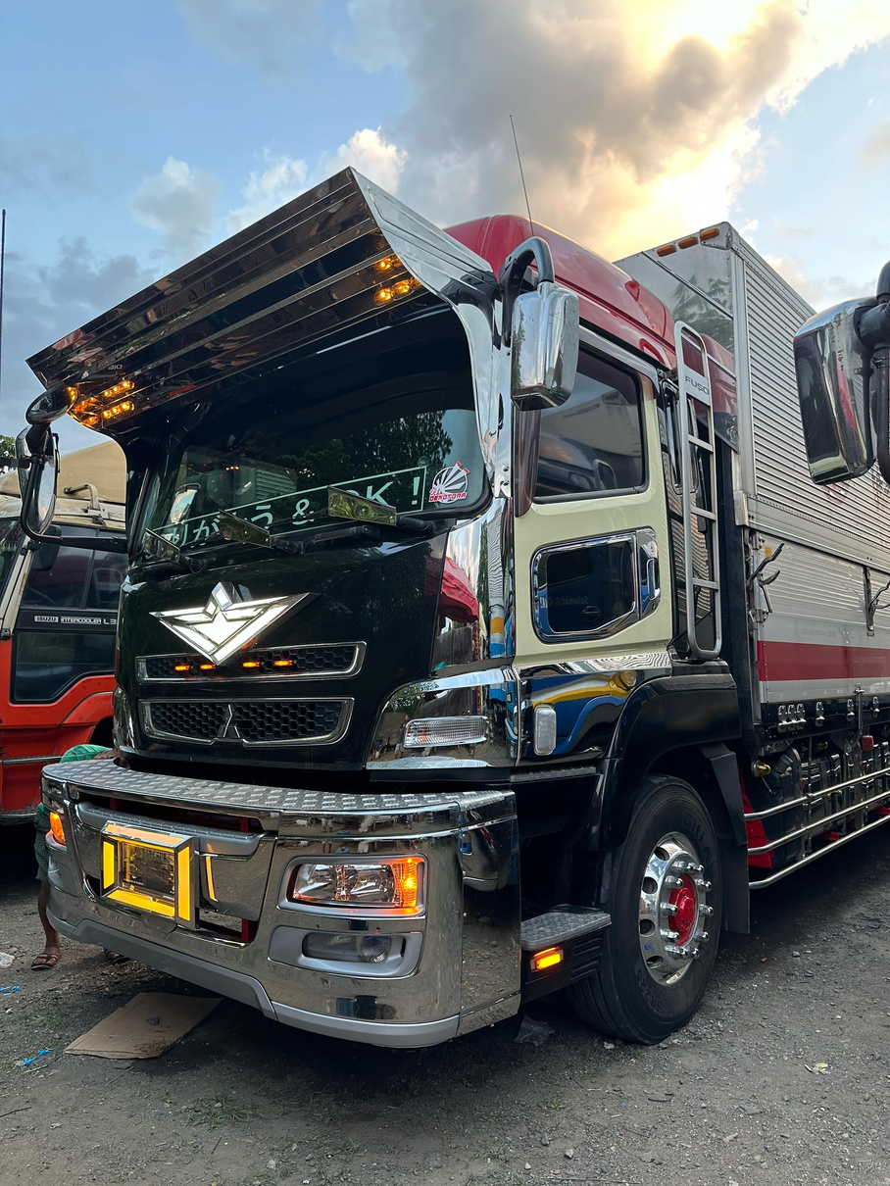
Project Objectives
This project aims to build an interactive web application for WMR Trucking Services to manage cargo delivery requests and logistics. It will use PHP, HTML, and CSS to create a responsive and user-friendly system. The platform will handle delivery requests, estimate cargo weight or volume, and update records in real time.

Slide 4
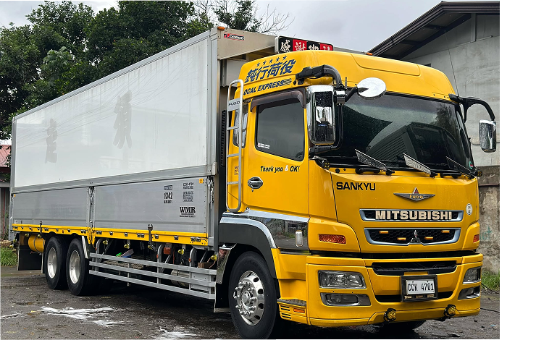
Project Description
The WMR Trucking Services website is made to help customers easily request a delivery. On the site, users can enter their name, business info, pick-up and delivery addresses, and cargo details like weight or number of boxes. They can also choose the dates for pick-up and delivery.

Slide 5
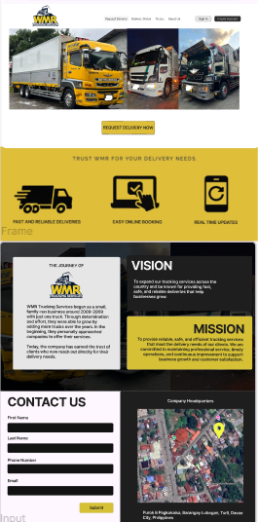
System Features and Functional Requirements
Features:
Company logo and tagline
Service highlights: Fast delivery,
easy booking, real-time updates
About Us:
Company history, mission, and vision
Public info about values and goals
Contact Us
Contact form (name, phone, email)
Google Maps location
Inquiry submission
Homepage

Slide 6
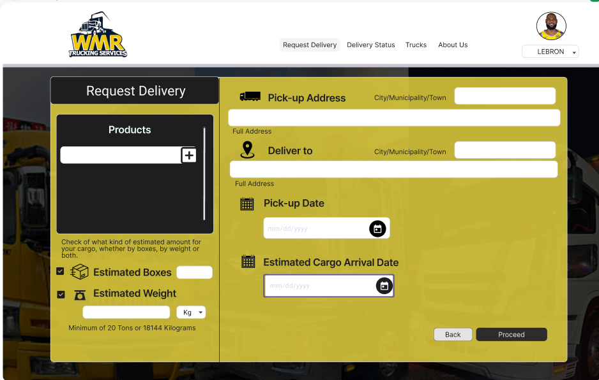
System Features and Functional Requirements
Request Delivery
Features:
Input product details, quantity, weight
Pick-up and delivery addresses
Choose pick-up and preferred arrival dates

Slide 7
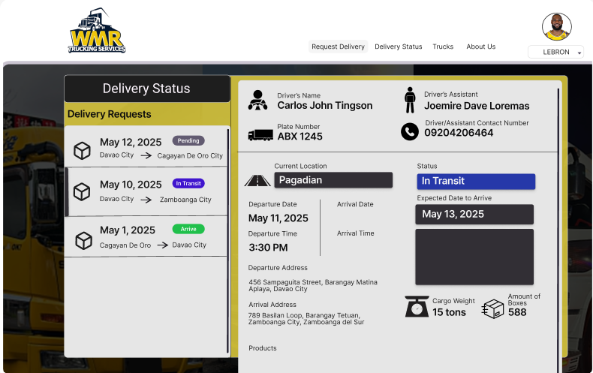
System Features and Functional Requirements
Delivery Status
Features:
Show driver/assistant info and truck plate
Real-time status updates (Pending, In Transit, etc.)
Track cargo location
View delivery details, departure/arrival info
Filter and view all transactions

Slide 8
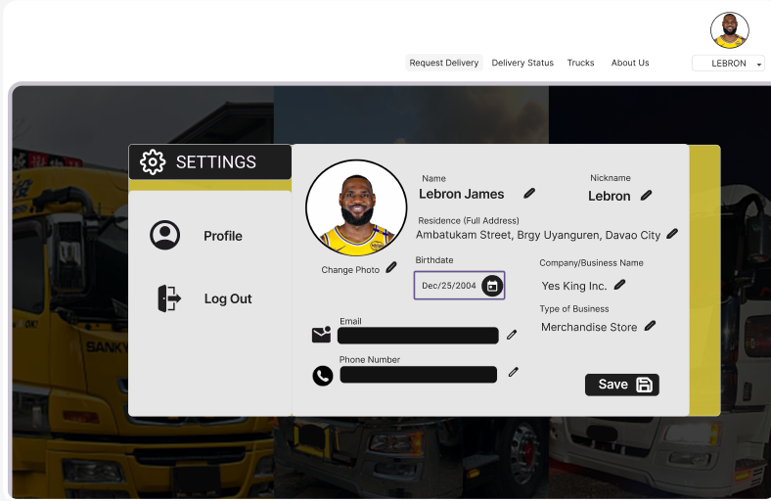
System Features and Functional Requirements
User Profile
Features:
Edit profile and upload picture
Update personal info
Logout option

Slide 9
System Features and Functional Requirements
User Profile
Features:
Edit profile and upload picture
Update personal info
Logout option

Slide 10
Key Learnings & Features
We built a cargo system to manage bookings, drivers, and delivery tracking. Key features include real-time status updates, role-based access, and automated records. This helps WMR improve delivery monitoring and customer satisfaction.

Slide 11
Future Suggestion
Add GPS tracking, online payments, and auto notifications. Improve security with stronger login and access control. A mobile-friendly design and route optimization can further boost efficiency.

Slide 12
In Conclusion
This project helped us create a system that improves how WMR Trucking Services handles deliveries. We learned a lot during the process and worked hard to build a useful and reliable platform. While there is still room for improvement, this system is a strong step forward.

Slide 13
Thank
You!

